Slide 1
Systems Architecture
A practical approach
SWEN-440
System Requirements and Architecture Engineering

Slide 2
Our Approach
  Weave architecture & requirements
  Start with architecture & architectural concepts
  Requirements (relating to what learnt on architecture)
  Goals
    Connect requirements and architecture
    More real-world approach
      Start architecting during requirements discussion
      Ask for requirement clarifications based on architecting
    Understanding of system components / layers
      Critically important for successful system design
    Hands-on activities on architecture shaping
    Plenty of writing
      Reflects architecture shaping process & communications
Notes:
i.e. Traditional approach is spend weeks on requirements & theory of requirements; then spend weeks on arch and arch theory. We will take a more hands on approach

Slide 3

The Well-Rounded Engineer
But do you understand what you, your code, and your system is doing?
A strong foundation makes a better architect.
Do you understand WHY & HOW your code works?
  Knowing the syntax is not enough
  How is a recursion executed really?
    Tail call optimization – why & when?
  Java string pool
    When is a new string is created & when is a string reused?
Do you understand all the pieces that come together to make it work?
  Physical aspect is important too
    Replication, multi-region setups, CAP theorem, edge servers,..
    Cloud is somebody’s computer
  Auth screen – Auth API, token storage, network routing, encryption, etc

Slide 4
Ripple Effects
Do you understand how changes in one area affect other areas?
  Everything is interconnected
  Change one thing -> ripple effect
    From UI to compiler optimizations
  What if we need to increase UI responsiveness?
    Create DB read-only replicas → new hardware and software
      Primary-Replica vs Multi-Leader
      Bin log vs transaction log
    Reconfigure DB
    Change network configuration
    Rewrite DAO layer
    Modify business logic

Slide 5
Architecture Has Consequences
Do you understand how the architecture and the software affect the people who use it?
  No defined cache strategy
    Ad-hoc implementations
    Slow page loading speed
    Customers abandon shopping carts
  Scalable architecture
    Additional hardware
    Seamless failover
    Users do not notice server crash
It’s all architecture
Until you understand the architecture, you can’t really build powerful applications with your code.

Slide 6
And what is an architect, anyway?
Architect:
[A] person who plans, designs and oversees the construction of [applications/ systems]
Not just a coder
  decision-maker
  a bridge between stakeholders and engineers
    understand needs
    design a solution
Example: decides how data flows among
  a mobile app
  web portals
  database
  security, reliability, regulations (e.g., healthcare), maintainability, scalability, available resources

Slide 7
And what is an architect, anyway?
What skills does the [software] architect need?
Computers & OS, Networks, Software
  Memory allocation, thread management, etc
  Network configuration / protocols / security, etc
  Languages, frameworks, libraries, applicability
People, Processes, Business, Law …
  Business understanding
  Requirements negotiations
Communications, Requirements, Analysis, …
  Clear documentation & technical design
Yeah, that’s a lot! Architecture requires you to know a lot about a lot. It is a high skill role.
And we will cover many of these topics [not all in depth … you have a lifetime for that!]

Slide 8
Some of the topics
Architecture is multi-disciplinary
  Platform Literacy – things architects need to understand
  Computer Basics
    Some people think of access speed: memory -> local storage -> network
    But in many cases, it’s: memory -> network -> local storage
  OS Basics
    OS process management affects web server request handling
    How to choose a thread pool size?
  Networking Basics
    How does SSL work?
  Architectural Decisions – things architects actually decide.
  Networking
    TCP vs UDP – reliability vs. latency.
  Data and AI/ML Basics
    Relational vs NoSQL - When & why? Hype vs. fit.
  APIs and Services
    REST vs GraphQL vs gRPC – why & when?
Some topics will be basic introduction

Slide 9
Why This Class Matters More Than Ever
AI can write code. It can’t make the calls that matter.
  Coding assistants now handle the boilerplate — syntax, scaffolding, routine implementation
    That’s the work junior engineers used to take on
  Where humans bring value: tradeoffs, failure modes, scalability, security
    e.g. choosing a caching strategy, deciding where a service boundary belongs
  Employers expect that judgment and those skills earlier in a career — not after five years in the field
“AI can handle portions of the job. It doesn’t grow into a senior engineer."
— Kinjal Vaishnav, Site Reliability Engineer, Oracle
“When anyone can build anything, knowing what’s worth building becomes the skill."
— Kent Beck, creator of Extreme Programming
“Calling AI a junior-developer replacement is one of the dumbest things I’ve ever heard."
— Matt Garman, CEO, AWS
“If all of those [entry-level tasks] are going to get taken over, you need to slot in at a higher level almost from day one."
— Hugo Malan, President, STEM & Telecom Practice, Kelly Services

Slide 10
What is Software Architecture?
The software architecture of a system is the set of structures needed to reason about the system. These structures comprise software elements, relations among them and the properties of both.
Notes:
The software architecture of a system is the set of structures needed to reason about the system. These structures comprise software elements, relations among them and the properties of both.
Architecture is an abstraction – We select and focus on certain details in the system. We do this to manage complexity
Architecture is a set of software structures:
Module Structures – the static design of the system
Component-and-Connector Structures – describe the dynamic aspects of the system
Allocation Structures – how the software maps into non-software entities, think about how a system is built.
Architecture is design, but not all design is architecture – many design decisions are unspecified by the architecture

Slide 11
What is Software Architecture?
Simpler:
  Components
    services, modules, components, …
  Relationships
    data flows, dependencies, interfaces, …
  Properties that matter are situational
    Performance? Connector latency
    Security? Encryption
    Availability? Retry mechanisms
More complex than it looks
  Multiple levels of abstraction
  Focus on one important aspect at a time
  Jump between aspects
Notes:
The software architecture of a system is the set of structures needed to reason about the system. These structures comprise software elements, relations among them and the properties of both.
Architecture is an abstraction – We select and focus on certain details in the system. We do this to manage complexity
Architecture is a set of software structures:
Module Structures – the static design of the system
Component-and-Connector Structures – describe the dynamic aspects of the system
Allocation Structures – how the software maps into non-software entities, think about how a system is built.
Architecture is design, but not all design is architecture – many design decisions are unspecified by the architecture

Slide 12
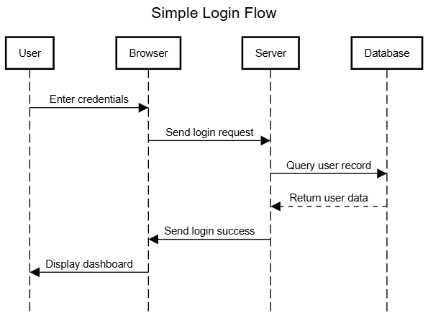
What is Software Architecture
  Software structure types
  Module structures
    How the system is organized (modules or layers)
    Static design
    Examples
      UI layer, business logic layer, data access layer
      Auth service, transaction service, message server, …
  Component-and-Connector structures
    How the component interact
    Dynamic behavior
    Examples
      Execution flow diagrams, data flow diagrams
        Requests hits a reverse proxy, API gateway, web server, microservices, database
  Allocation structures
    Map software components to non-software entities
    Examples
      On which server which service will be running
      On which cloud service which service will be running (e.g., EC2, EKS, Lambda functions)
Notes:
The software architecture of a system is the set of structures needed to reason about the system. These structures comprise software elements, relations among them and the properties of both.
Architecture is an abstraction – We select and focus on certain details in the system. We do this to manage complexity
Architecture is a set of software structures:
Module Structures – the static design of the system
Component-and-Connector Structures – describe the dynamic aspects of the system
Allocation Structures – how the software maps into non-software entities, think about how a system is built.
Architecture is design, but not all design is architecture – many design decisions are unspecified by the architecture

Slide 13
Business goals VS software goals
  Ride-sharing app
      business / end goal – grow market share by reducing wait time
        The business defines this; the architect cannot.
      software goal – implement real-time location tracking & smart matching
        The architect defines this in response to the business goal.
  Architecture turns requirements into a system design
    It’s not a blueprint – it’s a set of decisions about structure, components, and how they interact
    For the ride-sharing app, architecture decisions include:
      Style: event-driven backend for real-time processing
      Technology: websockets for client updates
      Components: geospatial indexing for matching
      Infrastructure: CDN for static resources
    These decisions are driven by quality attributes (covered soon) – e.g., latency drives the event-driven + websockets choice
Notes:
There is a chain here -> software is needed to achieve an end goal -> requirements specify and clarify that end goal -> an architecture provides the blueprint to get from the requirements to the goal

Slide 14
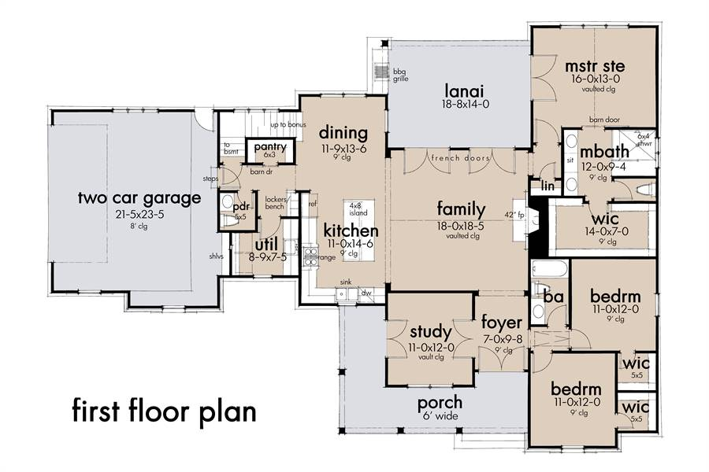
Architecture of a house
Consider building a house:
The architect decides things like:
Foundation structure
Framework (rooms, doors)
Wiring, plumbing
Then builders follow the instructions provided by architect
How does the architect know what to tell the builders?
They ask the client (Requirements!)
Software is similar – but easier to change than a physical building:
Architecture evolves as the system is built and as needs change
“Done” isn’t a moment – architecture keeps getting refined
https://www.thehousedesigners.com/plan/mill-creek-farm-7844/

Slide 15
Observations
  Every software system has an architecture
    Either planned – aligned with goals
    Or unplanned – accidental, accumulated
    Unplanned architectures tend to be worse, but not always
    Startup pattern: ad-hoc first, redesign at scale
      Sometimes intentional: ship fast => get funding => redo it right
  Architecture decisions affect users and the world
    UX – what the system feels like
    Privacy & security – what the system protects
    Cost & sustainability – infra spend, carbon footprint
    Compliance – what regulations the system can satisfy
Notes:
There is a chain here -> software is needed to achieve an end goal -> requirements specify and clarify that end goal -> an architecture provides the blueprint to get from the requirements to the goal

Slide 16
Architecture is an Abstraction
  Abstraction simplifies the view
    Selects what matters, suppresses the rest
    You can’t reason about a system if you have to think about every detail at once
  Architecture exposes what’s public, hides what’s internal
    APIs, public classes – the contract with the outside world
    Internals (private state, implementation) – free to change
    Each component can itself be decomposed – abstraction is recursive
  Good abstractions read like metaphors
    Desktop metaphor – files in folders, a trash can to discard them
    The screen pretends to be a desk; users get it instantly without a manual
  Abstractions stack – each layer hides the one below
    Drag & drop in Finder / Explorer
      Shell: mv source target
        Filesystem (files and directories)
          Hard drive (sectors on a platter)

Slide 17
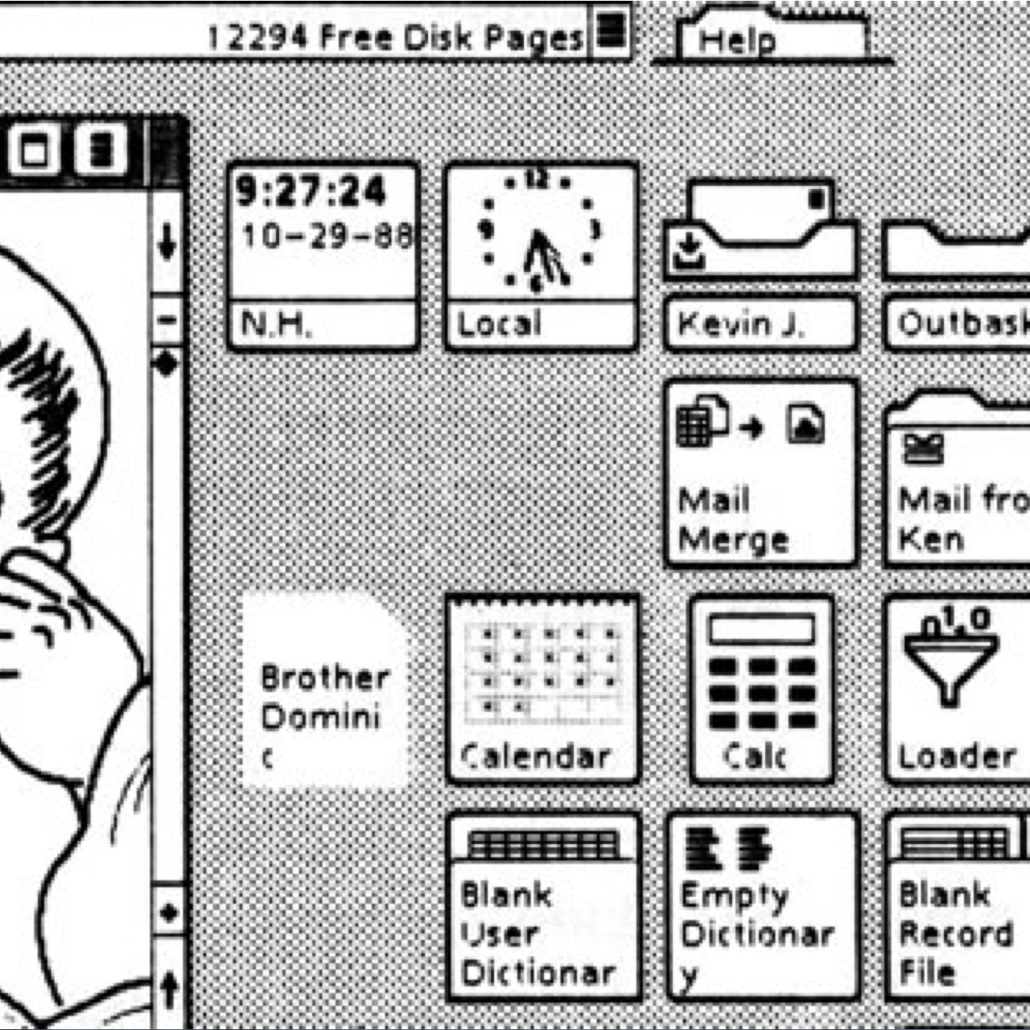
Xerox GlobalView (ViewPoint) - 1988
You’ve never used this desktop – but you recognize it instantly
  Files, folders, a clock, a calculator – the metaphor still works
  The hidden details (hardware, OS, code) are completely different now
  Architecture metaphors work the same way
Patterns are software architecture’s metaphors:
  Pipe & Filter
  Blackboard
  …and more (we’ll see them later)

Slide 18
The Benefit of Good Architecture
Increase
Value of reuse
Requirements
Architecture
Design
Code
Cost of defects
Increase
Good architecture isn’t just about convenience or scalability – it’s also about cost
The later you fix a defect, the more it costs → architecture saves in the long run
The earlier you identify shared elements, the cheaper the system becomes
  Example: 4 shared message services in production, a 5th in progress

Slide 19
What Makes a “Good” Architecture?
Product (Structural) Guidelines
Well-defined functional modules
  Information hiding – components don’t expose internals
  Separation of concerns – one component, one responsibility; avoid entanglement
  Well documented functionality – the contract is explicit; changes don't break others
Encapsulation enables change
  Modify a module without breaking the rest
Modularity enables independent teams
  Teams work in parallel; no one is blocked
Technical
Process

Slide 20
What Makes a “Good” Architecture?
Quality & Constraint Guidelines
Quality attributes – match the tactic to the attribute
  Use standard architectural patterns and tactics for each quality attribute
    Scalability → load balancing, stateless services
    Security → zero-trust network, encryption
    Maintainability → coding conventions, layered architecture
Vendor lock-in – favor open standards where practical
  Risks of locking in: licensing changes, cost increases, end of support
  Prefer open standards with multiple implementations – but it’s not always practical

Slide 21
What Makes a “Good” Architecture?
Design (Process) Guidelines
Build to change, not to last
  Modularity, loose coupling, clear interfaces
  Example: payment processing – plugin modules for new providers (strategy pattern)
Understand the users and the domain before designing
  Designing a ride-sharing app? Learn how drivers, dispatchers, riders interact
  Designing an accounting system? Go talk to accountants
https://www.infovista.com/blog/the-importance-of-software-architecture

Slide 22
What Makes a “Good” Architecture?
Decompose into layers and components – identify the key interfaces
  Separate “ride booking” from “payments” – other applications may need payment processing
  Abstraction enables Lego-brick thinking: assemble systems from reusable parts
Design incrementally – don’t try to get it all right upfront
  Requirements will change and become clearer
  Technical limitations will emerge
  Start with a monolith; extract microservices when scale demands it
    Fewer moving parts = faster iteration while requirements are still shifting
    Service boundaries reveal themselves as the system grows – premature splitting locks in the wrong ones
https://www.infovista.com/blog/the-importance-of-software-architecture

Slide 23
What Makes a “Good” Architecture?
Discipline (Long-Term) Guidelines
Document your decisions – not just what, but why
  Reasons, alternatives considered, factors that drove the choice
  Future architects won’t need to re-evaluate everything from scratch
  Helps engineers understand context
Invest in architecture – enough upfront, not everything upfront
  Spend upfront effort where it’s hardest to change later – data models, module boundaries, core protocols
  Make it flexible / maintainable
  Skimping here makes everything downstream more expensive
Retrospect – get better with every project
  What worked? What would you do differently next time?
  Your past projects are your best source of architectural intuition
https://www.infovista.com/blog/the-importance-of-software-architecture

Slide 24
Architecture is about Behavior
Structure is only half the picture – the other half is how the system behaves
Who interacts with the system, and how?
  Drivers, riders, dispatchers, support – each has different flows
  Push notifications, server APIs, background jobs – not all behavior is user-initiated
What does the system do for each request?
  Use cases and their implementations – the happy path
What happens when things go wrong?
  For example, payment gateway is down → retry 3× (exponential backoff) → mark “pending payment” → notify support
  Happy paths are easy. Unhappy paths are where the real complexity lives.
Understanding, capturing, documenting and carrying these behaviors through to implementation is Software Architecture.
Notes:
Pick up here

Slide 25
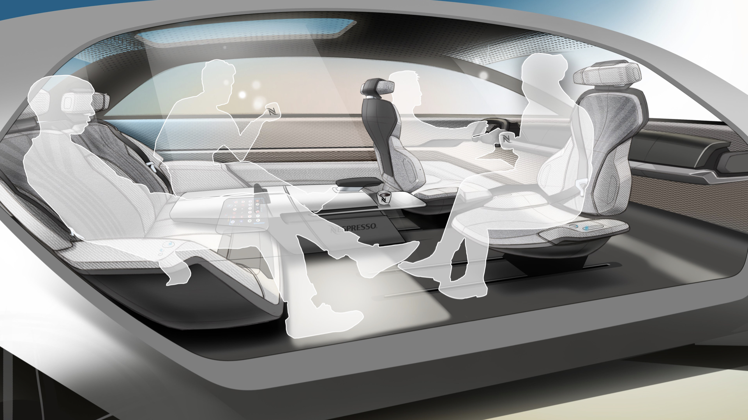
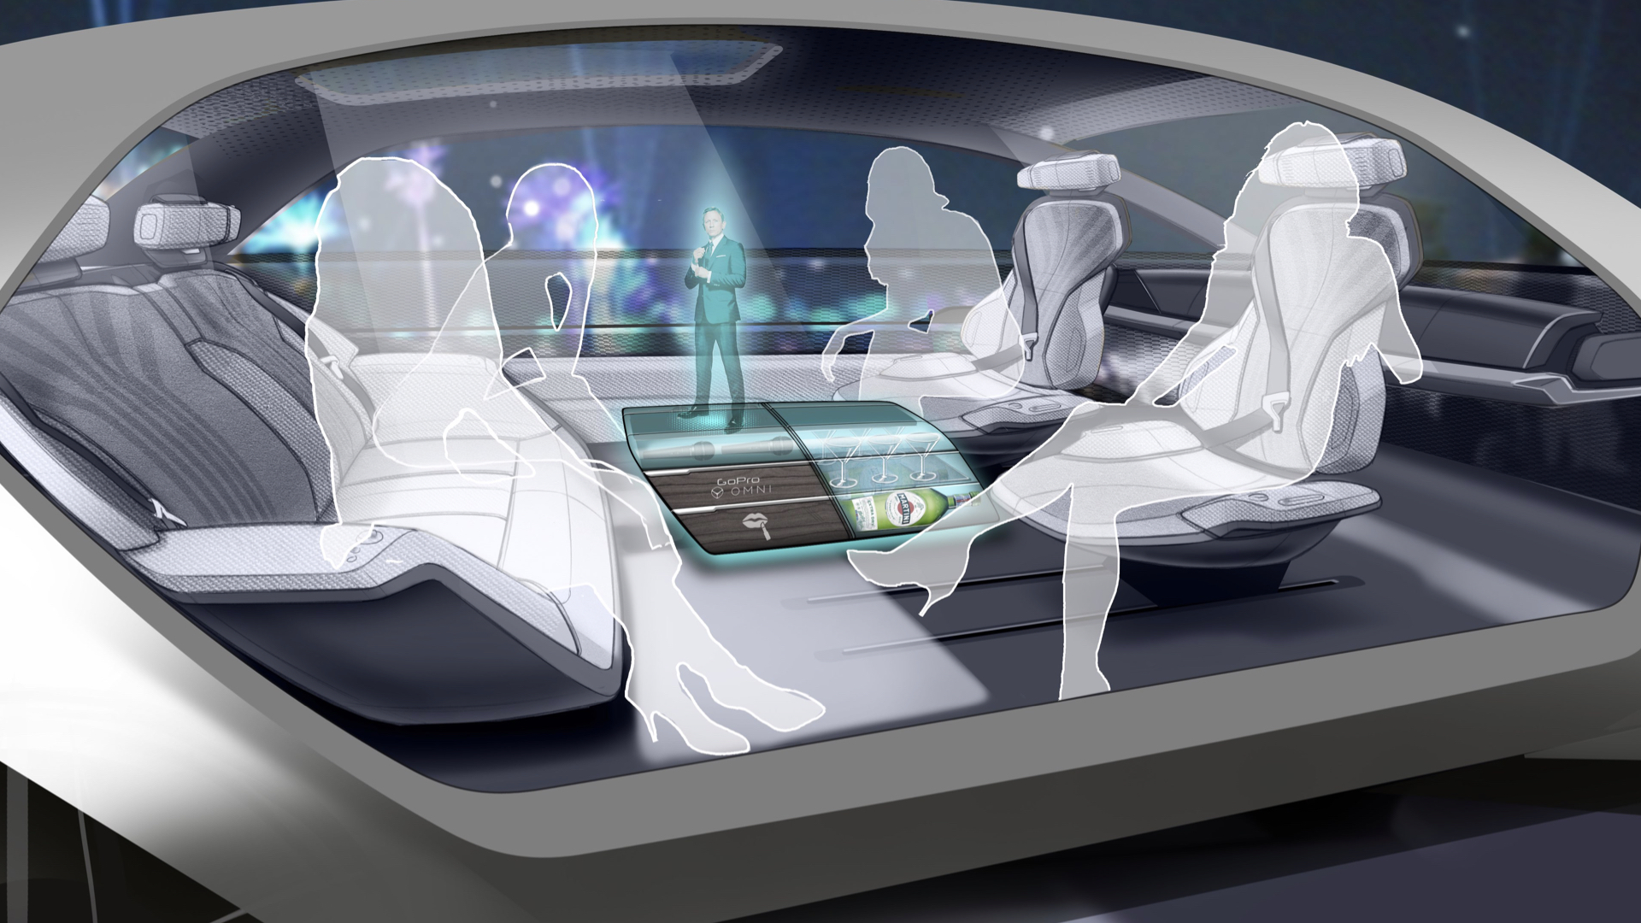
Concept Car – Understanding Behavior
Design depends on required behavior / functionality
Same vehicle, different behavior
Lounge mode: passengers face each other – no driver controls visible
Entertainment mode: central holographic display, seats swivel inward
The architecture has to support both
Designing an autonomous car interior for endless possibilities
For Grammer AG, a leading interior component supplier, we defined a vision on how semi-autonomous car interiors might look for the next generation of cars with Level 4 Autonomy.
https://www.granstudio.com/grammer
Notes:
This is about ‘How will people use the thing I am building. If it’s not ‘driver/ passenger’, you would arrange seating differently

Slide 26
What Type of Requirements Matter to Architecture?
Does the architect need every detail? No – only what affects the architecture.
Consider the house analogy:
  Things that matter (architectural):
    Physical: # of stories, # of rooms, open-space layout
    Site: orientation to sun, geography, climate
    Constraints: local building codes, ordinances
    Systems: heating type, plumbing layout
  Things that don’t: paint color, trim, kitchen appliances
    Cosmetic & interchangeable – easy to change later
Same idea in software: focus on what shapes the system; leave skinnable details for later.
Notes:
Software parallels
matter: data models, module boundaries, protocols
don't matter: UI color schemes, 3rd party open source libraries

Slide 27
What type of requirements matter to Architecture?
Ask yourself: Self, does this requirement…
  Shape structural decisions? (e.g., a reporting module vs. a real-time pipeline)
  Affect system behavior? (e.g., the authentication flow matters; a report’s background color doesn’t)
  Restrict possible technologies? (e.g., Android app → no Swift)
  Come with a legal or compliance obligation? (e.g., GDPR, HIPAA)
Three kinds of requirements that usually matter:
  User → “users must be able to reset their password”
  Workflow → “new orders are routed to the dispatch mailbox”
  Environment & Constraints → “must run on Windows and Linux”
… but not every detail. No, I still don’t care about button color.
Notes:
Use room/ light example here…

Slide 28
ASRs
ASR = Architecturally Significant Requirement
  A requirement that drives a structural, behavioral, technological, or compliance decision
  The previous slide’s SARC questions are one useful lens – researchers have proposed others (business value, stakeholder concern, cross-cutting impact, …)
The set of ASRs isn’t fixed – it evolves:
  You can misclassify a requirement at first – what looked cosmetic turns out to drive structure
    “riders can split the fare with friends” looks like a payments feature – until you find it breaks the single-payer transaction model and forces multi-party authorization
  New requirements arrive mid-project (regulation changes, new customer segment, scale shift)
  “Other” requirements can become ASRs when context changes
    e.g., “show yesterday’s ride history” is fine – until the product needs live driver positions on the map, forcing event streams and push delivery
Re-evaluate ASRs as the project evolves. They’re not set in stone.
Notes:
Watch out for hidden impacts of requirements that will disrupt your architecture assumptions

Slide 29
ASRs
A real ASR you didn’t see coming
  Designed a system for the US market
  No way to delete user data – never needed it
  Business expanded to the EU
  Hello, GDPR
  Now: delete the data from everywhere
    databases (dozens+)
    data lakes & data marts
    logs
    backups
    etc.
  Result: massive system redesign
The “Other” requirement that became architecturally significant the moment context changed.
Notes:
Watch out for hidden impacts of requirements that will disrupt your architecture assumptions

Slide 30
Gall’s law
1975, John Gall – pediatrician and systems theorist:
“A complex system that works is invariably found to have evolved from a simple system that worked.”
“A complex system designed from scratch never works and cannot be patched up to make it work. You have to start over with a working simple system.”
Thought experiment: try to build Google from scratch.
No “big-bang theory.” Architecture – like everything else in software – is inherently iterative.
John Gall (author) - Wikipedia

Slide 31
Understanding basics
We will build from the ground up – just like a house
In software, what makes an application? What are the main pieces?
  Computer – executes your code
  Connectors (networks) – communications between your systems
  Components – existing tools and services you compose
  And then your own software on top
Before you can design software architecture, you must be literate in the basics
  Before you can frame a house, you need to know what 2×4s and joists are
  We will give you a (brief) foundation in computer literacy before architecture
To be an architect, you must be able to analyze and measure
  Quality attributes only count if you can measure them – we’ll spend time on how

Slide 32
Discussion Assignment (SAiP Ch1, Q2)
How does an architecture serve as a basis for…
  Analysis – what does it let you reason about that the code alone doesn’t?
  Decision-making – what choices become easier (or possible) once it exists?
  Communication – who needs to read architecture, and why?
Notes:
What qualities can be analyzed if we have an architecture? E.g., performance -> layered architecture -> latency -> how to measure & analyze?

